Slide 1
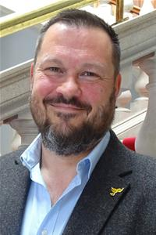
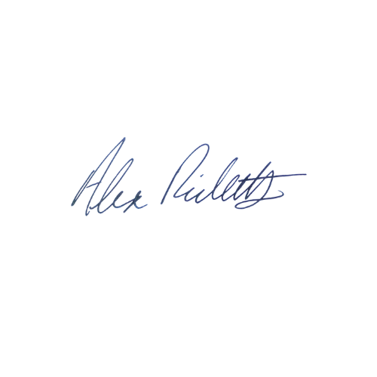
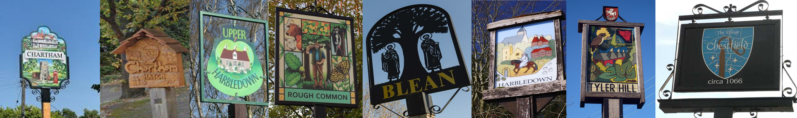
Canterbury North Update
November 2025
Tel: 07900 081955
CCC Email: alex.ricketts@councillor.canterbury.gov.uk
KCC Email: alex.ricketts@kent.gov.uk
Cllr Alex Ricketts
It’s been a busy time recently, both in Canterbury and Maidstone, with a mixed bag of good news and bad.
It’s difficult to ignore the antics from across the chamber at County Hall, with their initial 57 councillors now down to 48 (at time of writing) due to a mix of sackings, defections and legal difficulties. This has serious implications for decision making and it also appears to be disrupting the work of committees: I’m a member of both the Regulation Committee and the Health Overview and Scrutiny Committee and, once we finally met after the cancellations of early meetings, the chairs of both have since been removed by the leader. Both do important work, and given the pressures and upheaval within the NHS the work of the latter is vital. The Liberal Democrats proposed a motion to set up a cross party and multi-agency Health and Social Care Kent Improvement Board, which was voted down by the majority party.
In further evidence of disruption to the conducting of council business, we are still waiting for a draft budget from the KCC administration, despite it being usual for something to have been prepared and ready for consultation by now.
By contrast Canterbury City Council has issued a budget consultation, and you can respond to each section using the links on the following page. Finances are still tight, but there are some interesting proposals, especially the provision of £5m for purchasing new social housing. Canterbury City Council meets again on 20th November where Local Government Reorganisation will be discussed, and I would love to hear your views.
As ever I hope to meet you in person either at Parish Council meetings, events, at our national headline winning Hare at Blean, or even at the Rough Common Village Hall Christmas Quiz, which I hear will have an excellent quizmaster.
All the best,

Slide 2
Canterbury North Update
November 2025
Tel: 07900 081955
CCC Email: alex.ricketts@councillor.canterbury.gov.uk
KCC Email: alex.ricketts@kent.gov.uk
Cllr Alex Ricketts
CCC Updates
Canterbury City Council is currently consulting on its budget for next year. The links provided include further details on each of these proposals, the consultation is open until 9am on Tuesday 6 January 2026.
  General Fund budget consultation 2026/27
  Proposed changes to charges and conditions in council car parks for 2026/27
  Housing Revenue Account budget consultation 2026/27
  Proposed changes to street trading licence fees for 2026/27
  Proposed changes to scrap metal dealer licence fees for 2026/27
The Local Plan Regulation 18 consultation has now closed, and responses are being analysed.
The deadline for submitting changes to the annual parking review (e.g. double yellow lines) is 1st December.
KCC Updates
KCC Country Parks survey https://www.lake-research.com/kccparks The survey will close at midnight on Friday 14th November 2025
National Highways and Transport Survey 2025-26 https://letstalk.kent.gov.uk/nht-2025-26 Surveys close 28 February 2026
The Shelford Landfill site consultation has now closed, although I will be meeting with the owners along with residents and fellow to discuss conditions: https://consult.environment-agency.gov.uk/psc/ct2-0pu-valencia-waste-kent-ltd-xp3434hx-v018/

