Slide 1
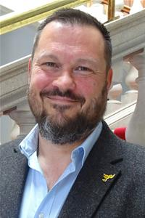
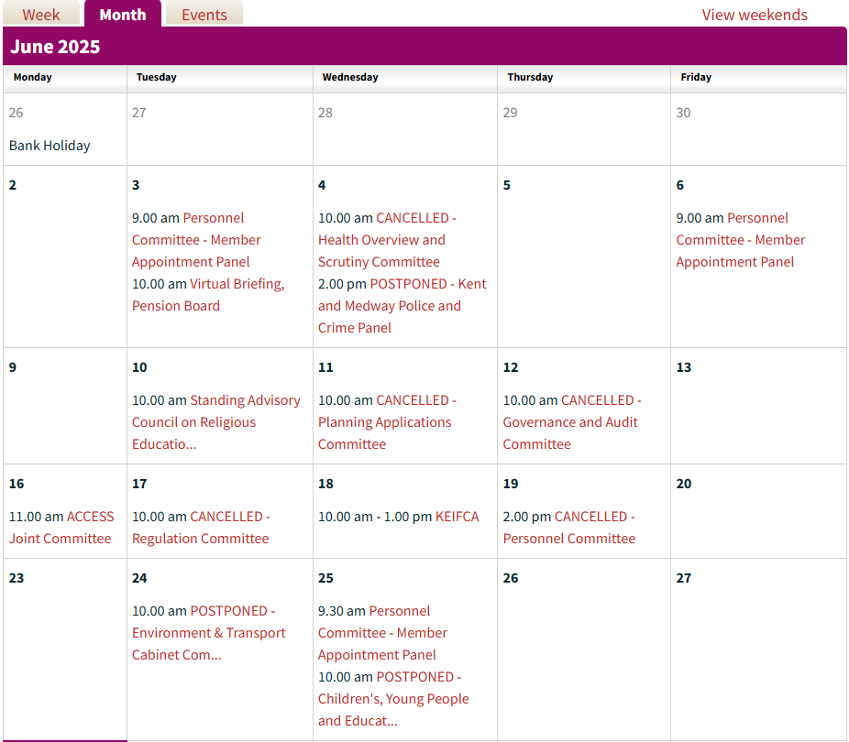
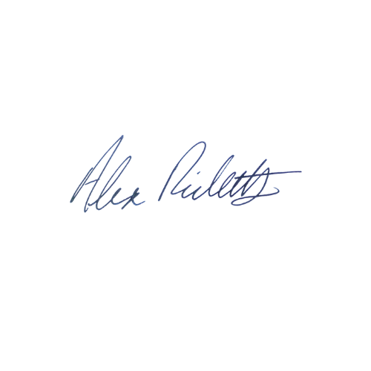
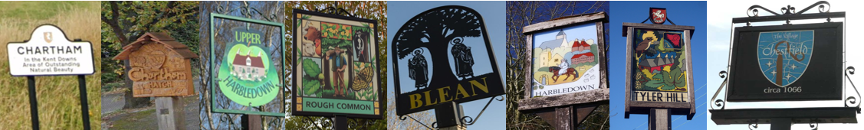
Canterbury North Update: May 2025
Tel: 07900 081955
CCC Email: alex.ricketts@councillor.canterbury.gov.uk
KCC Email: alex.ricketts@kent.gov.uk
Cllr Alex Ricketts
Welcome to a rather hot and sticky June update, and a quick apology if you have not received a leaflet from us recently, the hot weather has hampered delivery a little (despite many volunteers braving the heat).
From a KCC point of view it has been a relatively quiet June, as most of the committee meetings have been postponed or cancelled (see pic). I’m hopeful that I will get to attend a meeting soon, especially the Health Overview and Scrutiny Committee. In the meantime I have been busy attending the training provided by officers and working with my group colleagues. I’m pleased to say the officers I have spoken to on a number of issues have been incredibly helpful.
One major issue has been the Ham Shades Lane Bridge and, with the help of my Chestfield Ward colleague James Flanagan, we convened a meeting between officers from KCC and CCC to discuss improving safety on the footpath. You may also have seen that a resident discovered an open manhole on Church Street Playing Field, the response from KCC Highways was incredibly swift and diligent. They are still investigating the ownership of the hole, but did all they could to prevent further risk to residents.
I’m preparing my member Highways Improvement Plan, so I’m keen to hear of any issues you would like to include.
I’m pleased to say that Canterbury City Council is holding meetings, and I steered a licencing item through Cabinet, then chaired the Joint Transportation Board. I have been in discussions with residents and officers about the work that has begun on the development at Blean Common, and I’m hoping to meet the developer in the near future. I attended Blean Parish Council and the CT5 forum’s sustainable transport group, I may also have served you a burger at the Blean Village fete, which was a roaring success, despite the kids winning the tug of war - again. With respect to these fine events, the highlight of my month was marching in the Canterbury Pride parade, behind the civic team. A brilliant event, delivered under difficult circumstances.
I have dealt with inquiries ranging from parking, to missed or damaged bins, overgrown vegetation, blue badges, potholes(of course), roadworks, school placements, and many others. Please do get in touch if I can help you with anything.
If you’re free on 12th July I will be appearing at the Rough Common Village fete, where you might be able to pelt me with wet sponges…although I’m hoping this year it will be “Soak a Sheriff” instead.
All the best,

