Slide 1
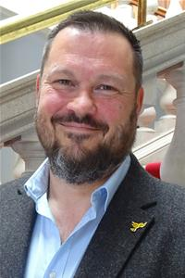
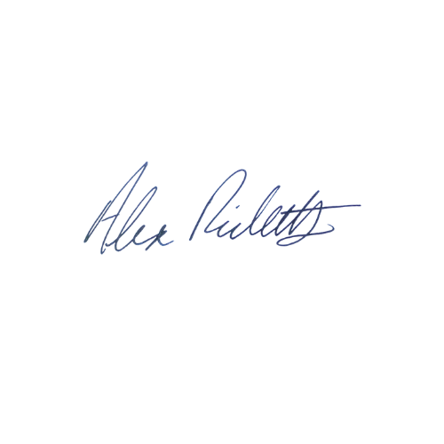
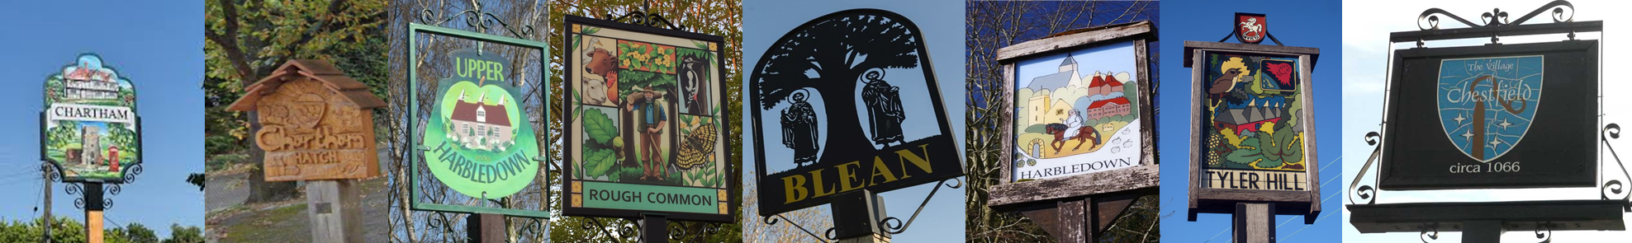
Canterbury North Update
January 2026
Tel: 07900 081955
CCC Email: alex.ricketts@councillor.canterbury.gov.uk
KCC Email: alex.ricketts@kent.gov.uk
Cllr Alex Ricketts
Hello!
2026 has well and truly begun - not even two weeks in and half the area is without running water.
At the Kent County Council meeting on 18th December, the Liberal Democrat group put forward a motion, prompted by the failures of South East Water in Tunbridge Wells, to call for a short focused inquiry into water supply issues in Kent. Many members highlighted issues in their own area, and I spoke about the shortages we experienced in and around Whitstable last year. I’m pleased to say that motion passed unanimously, with members from all parties and areas sharing stories of the same excuses and the same failures. We will continue to hold the water companies to account, and in the meantime I’m pleased to say that both KCC and CCC officers have stepped up to help residents where support from the utilities has been sorely lacking.
The first weeks of the year finally saw the publication of KCC’s draft budget. It is usual for this to be published well before Christmas, but there will now be a month before it goes to County Council. So far we have seen the headline of a 3.99% increase in council tax. Given the budget overspend and rising costs even the maximum 5% would not be sufficient to meet all of the demands on Kent’s budget, we are currently assessing if it will be a raid on reserves or cuts vital services. It could be both.
There are a few pieces of good news, like the proposal for a 20mph zone in Chartham Hatch and the fact that Canterbury City Council has put forward a balanced budget including spending on social housing. If you see me about, stop me for a chat, although maybe wait until the water is back on, and I’ve had a chance to shower!
All the best,

Slide 2
Canterbury North Update
November 2025
Tel: 07900 081955
CCC Email: alex.ricketts@councillor.canterbury.gov.uk
KCC Email: alex.ricketts@kent.gov.uk
Cllr Alex Ricketts
CCC Updates
Canterbury City Council’s budget consultation is now closed and the final budget will go to Council on 23rd February.
The results of the Regulation 18 Local Plan consultation are currently being assessed and the final Regulation 19 document will be prepared over the next couple of months.
It was agreed at Council on 8th January that options for a Community Governance Review would be examined by cabinet, to look at the options for parish and town councils under the new Unitary authority.
KCC Updates
KCC has finally published a draft budget, which will be discussed at the January Cabinet meetings before approval by County Council on 12 February 2026, you can read more here: https://letstalk.kent.gov.uk/budget-consultation-2026-27
I've recently been asked about the availability of on-street EV charging facilities, if you’d like your street considered, you can apply here: https://letstalk.kent.gov.uk/on-street-ev
National Highways and Transport Survey 2025-26 is still open until February 28: https://letstalk.kent.gov.uk/nht-2025-26
The consultation on the proposed variation to the environmental permit for the Shelford Landfill Site has closed, and you can read submissions here: https://consult.environment-agency.gov.uk/psc/ct2-0pu-valencia-waste-kent-ltd-xp3434hx-v018/?fbclid=IwY2xjawNplkhleHRuA2FlbQIxMABicmlkETBsWExnbW5zak1Wd3R5Z2xnAR5NMo_ihcGFHJjBVOkGYiP_pC6L5Tk4G-nbq3myI8LXXHCDZOwDvp0oKilIXQ_aem_sarJOtEQNAJfGn-dPBpYdg a planning application is likely to come forward soon.

